Slide 1
(ANY TIME MOVIE TICKET)
PROJECT NAME ATMT
MADE BY:- SOLANKI TRUSHEN

Slide 2
Project introduction
Is project is about movie ticket counter
It is easily to any user to print their ticket in this project first we find the user age if user are less than 18 year they not able to buy online ticket if user 18 + they are able to buy online ticket.
In second scenario user can choose their choice of movie And the
third and last scenario how many ticket user are want to print This is first phase of the this project

Slide 3
second phase of this project
Is the second phase about selections.
In the second phase user can select seats in silver/gold/diamond.
In second scenario program print all details about movies and seat price and program will print bill of movie tickets.
In third scenario user can choose multiple payment methods for paying bill of tickets
four and last scenario print all movie tickets.

Slide 4
project scope
There are seven scope of this system
1.Age checker
2. Choose movies
3.Seat selection
4.Ticket quantity
5. Choose multiple payment methods
6.Print tickets
7.CONTINUE LOOPING

Slide 5
summary of code
CLASS AND OBJECT
BASIC OPERATORS
USER DEFINED FUNCTIONS
CONSTRUCTOR
INHERITANCE

Slide 6
Project algorithm
Step 1 − START.
Step 2- declare ten integers i, age, a, count, total, capacity, p, select, f, s
Step 3- declare two character variable name, movie
Step 4- print a message welcome to the jio cinema.
Step 5- print ask to user what is your name.
Step 6- print ask to user what is his/her age.
Step 7- IF(age<=18) Then
output The list of movies you can watch .
print selected movie name and details.
print select your seats in silver/gold/diamond
print how many tickets you want.
print selected seat price and total amount
print multiple payment methods and select any one
print all tickets

Slide 7
else
You are not able to buy tickets
Step 8- stop

Slide 8
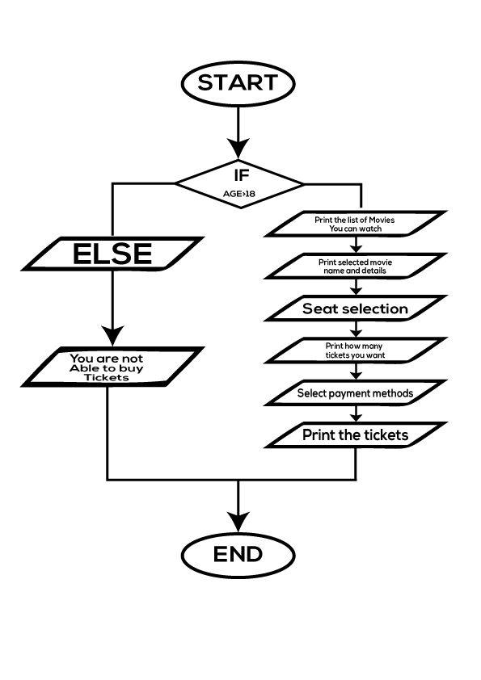
flowchart

Slide 9
logic of this program
This message was print Welcome to the JIO cinema
User enter his/her name
User enter his/her age
If user age is a greater-than 18 then print movies list
User select movie and then print movie name and details
Then user select seats in silver/gold/diamond
Then ask for user to how many tickets his/her wants
Print total bill and select payment methods
Print the movie tickets
If user age is a less -than 18 then user no able to buy tickets
End of this programme
This message was print thankyou for choosing joi cinema

Slide 10
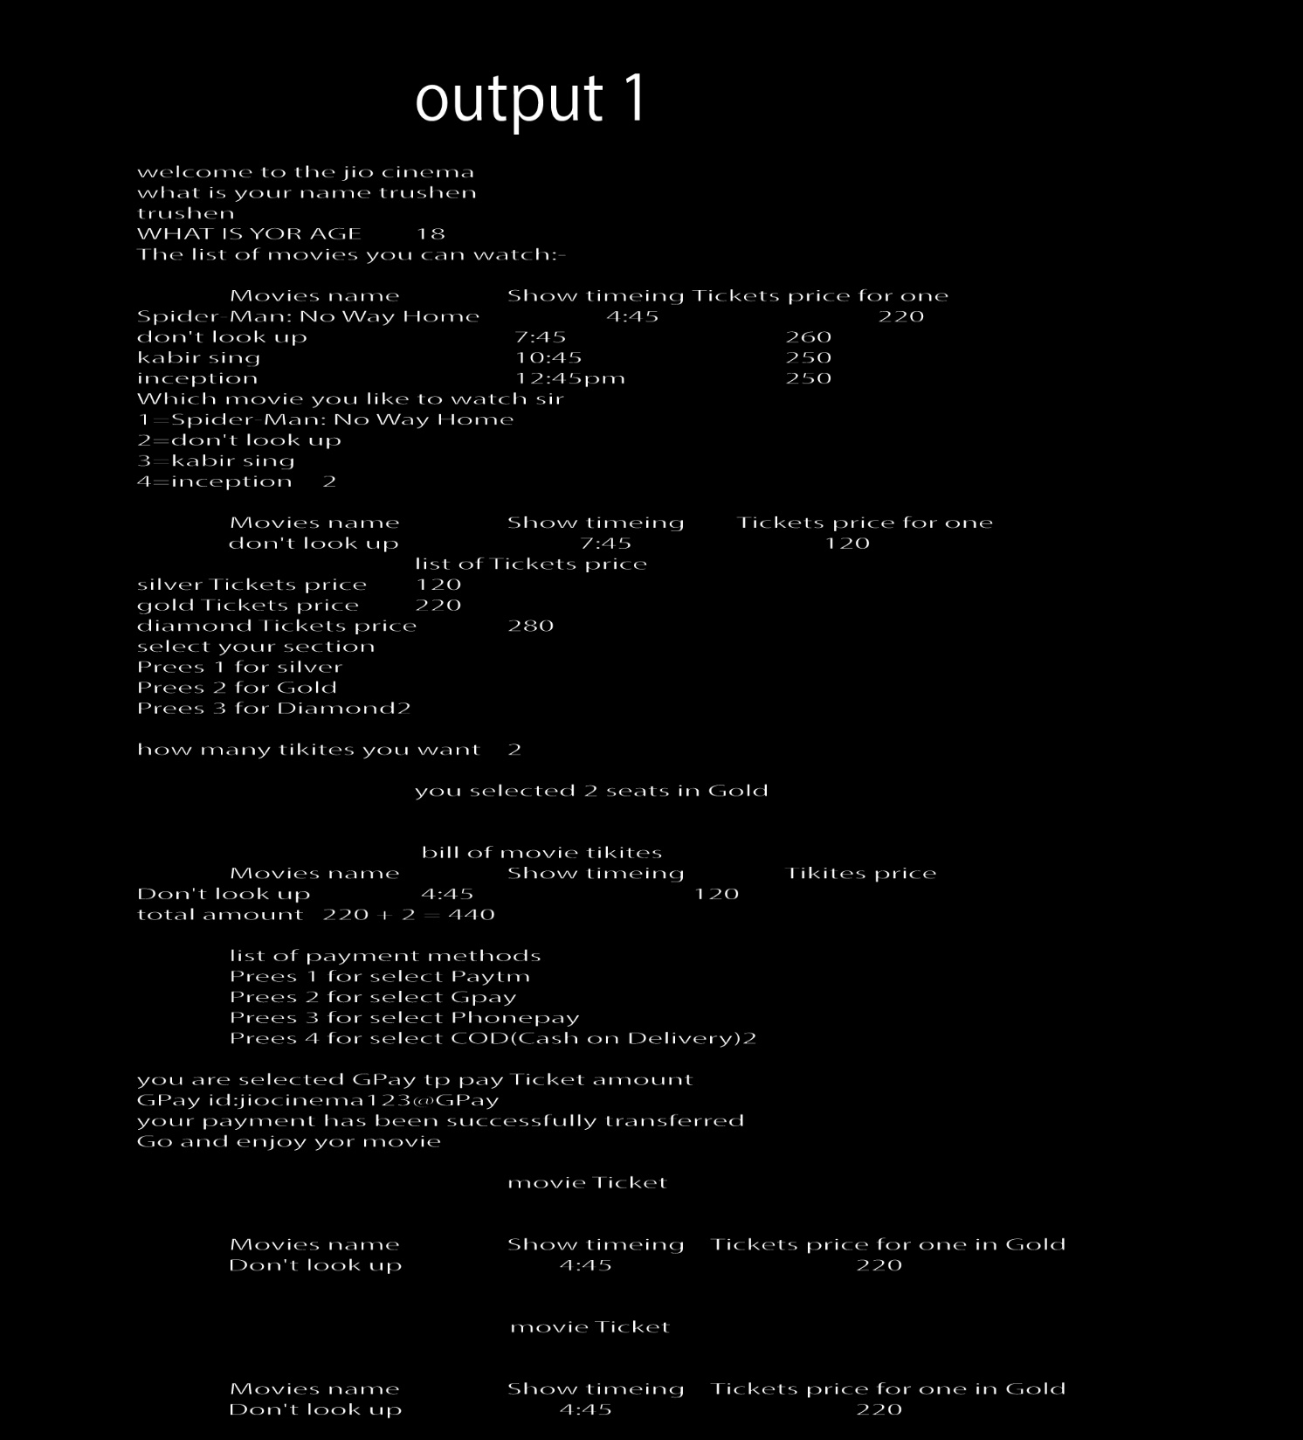
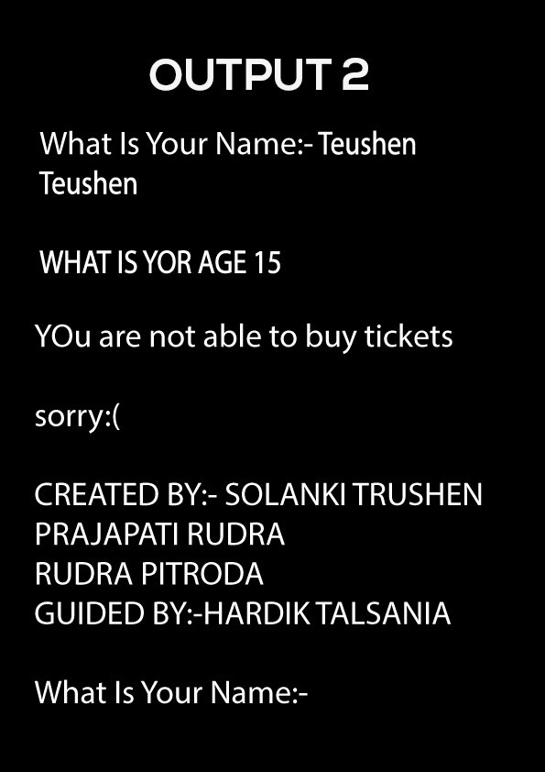

Slide 11
Thank you sir

